Slide 2
Words to describe Atrial Fibrillation

Slide 3
Words to describe Atrial Fibrillation

Slide 4
A patient’s journey through atrial fibrillation

Slide 5
Atrial fibrillation

Slide 6
Atrial fibrillation – Pathogenesis

Slide 7
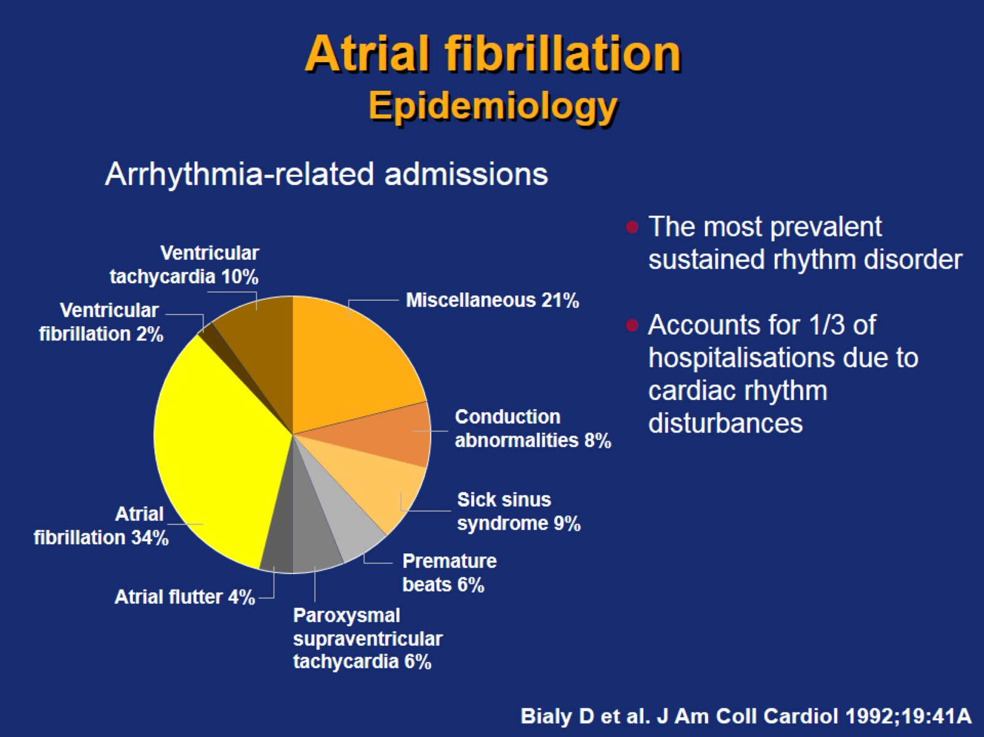
Atrial fibrillation Epidemiology

Slide 8
AF prevalence increases with age

Slide 9
Many AF patients have predisposing conditions

Slide 11
Prevalence of atrial fibrillation increases with heart failure, valvular heart disease or coronary artery disease

Slide 12
Atrial fibrillation increases mortality

Slide 13
Atrial fibrillation is a progressive disease

Slide 14
Atrial fibrillation – Consequences

Slide 15
Atrial fibrillation – Classification

Slide 16
Atrial fibrillation – Manifestations

Slide 17
Quality of life

Slide 18
Awareness of arrhythmia

Slide 19
Exercise tolerance

Slide 20
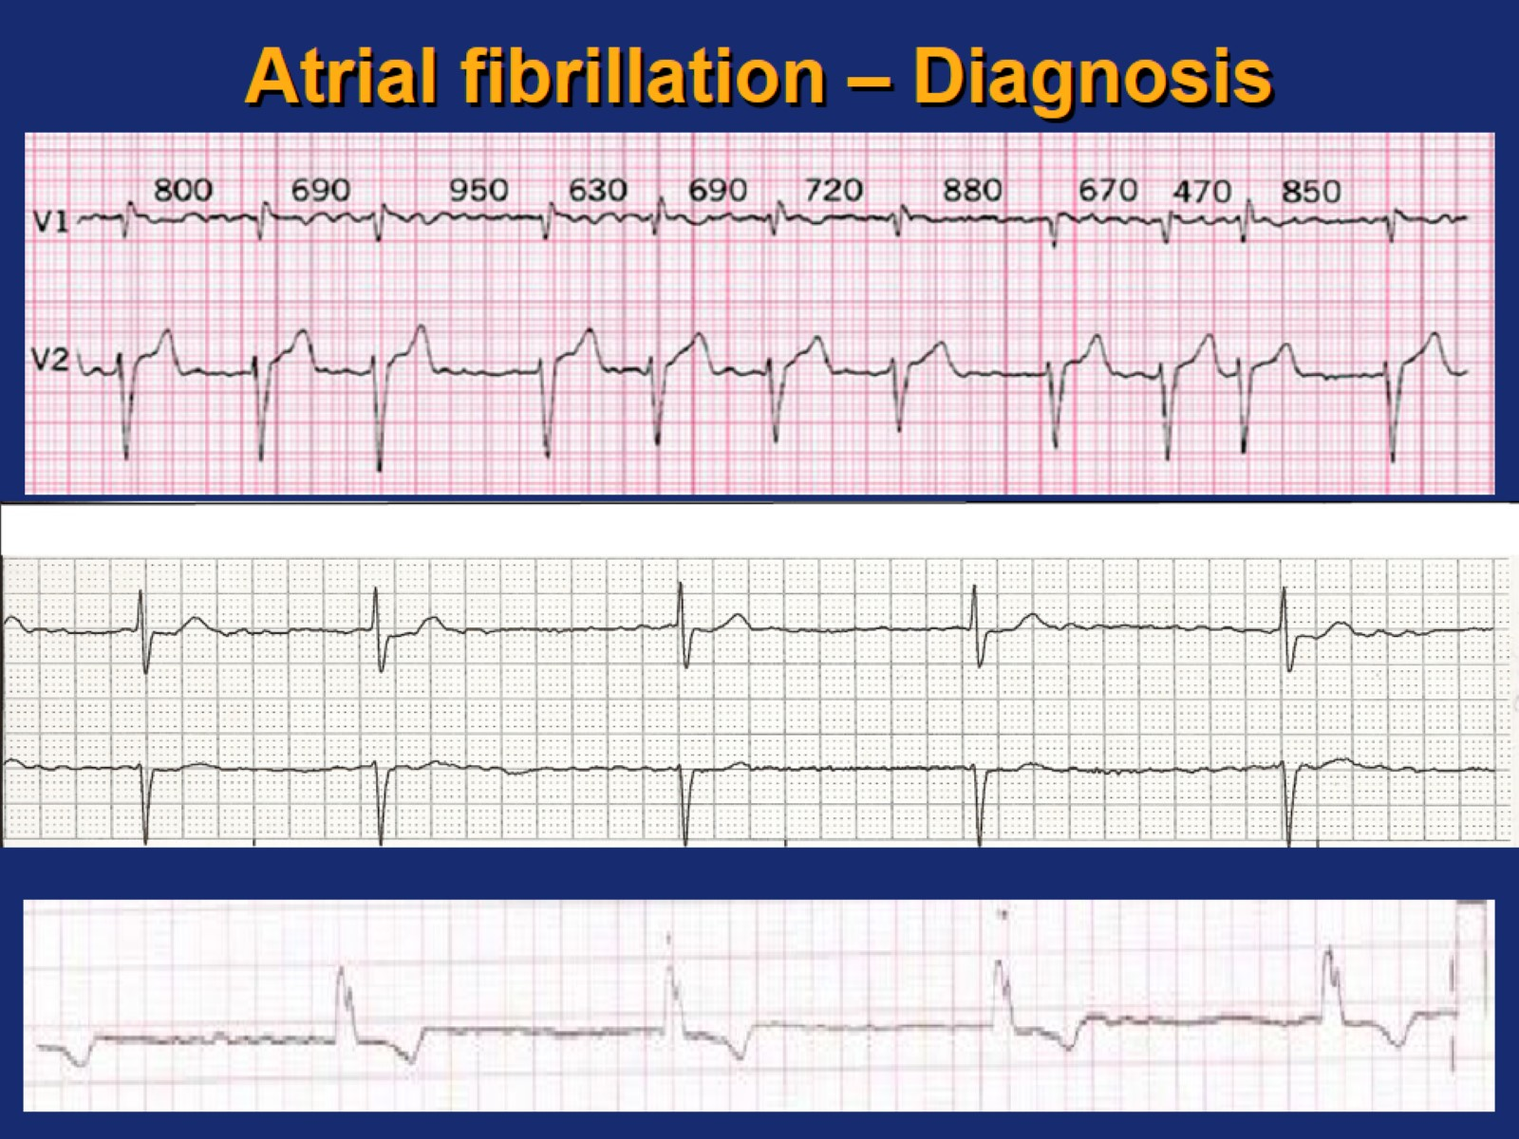
Atrial fibrillation – Diagnosis

Slide 21
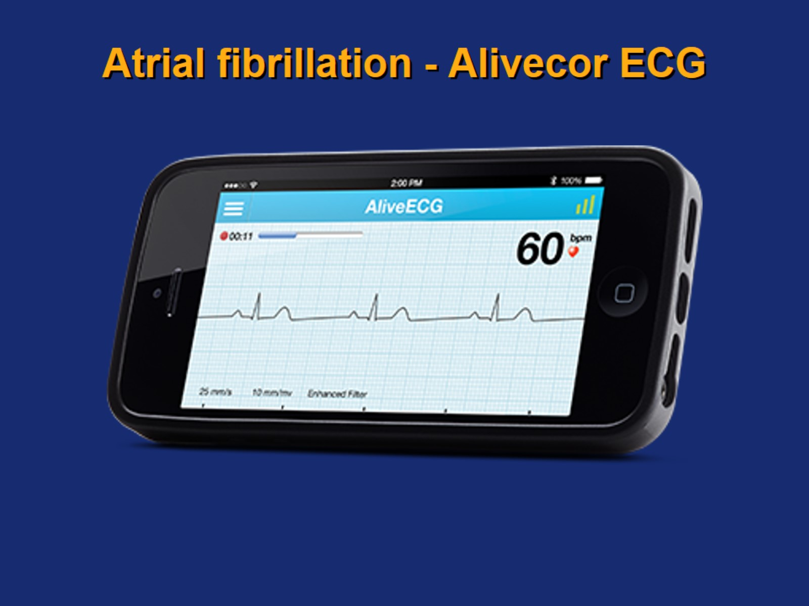
Atrial fibrillation - Alivecor ECG

Slide 22
Atrial fibrillation - Holter monitor

Slide 23
Atrial fibrillation - Event monitor

Slide 25
Should everyone with AF have an echocardiogram?

Slide 26
Echo Parameters/CHADSVASC for prediction of stroke risk

Slide 27
Strategies for treating atrial fibrillation

Slide 28
Symptoms in Atrial fibrillation

Slide 30
Rhythm and rate control approaches

Slide 31
Persistent Atrial Fibrillation

Slide 32
AFFIRM Trial Design

Slide 33
AFFIRM Results

Slide 34
AFFIRM Results

Slide 35
Hospitalisation in the AFFIRM Trial

Slide 36
Is sinus rhythm associated with better clinical outcomes than rate control?

Slide 37
When to use rhythm control?

Slide 38
Rhythm control: aims

Slide 39
Rhythm control approaches

Slide 40
Intensive lifestyle intervention in patients with paroxysmal AF

Slide 41
Symptom Burden and Severity in Patients With AF

Slide 42
Lifestyle intervention

Slide 43
Cardioversion

Slide 45
Electrical cardioversion

Slide 46
Electrical cardioversion

Slide 47
Effectiveness of “Pill in the Pocket”

Slide 48
Class IC agents

Slide 49
Pharmacological cardioversion

Slide 50
Long-term antiarrhythmic treatment

Slide 51
Prevention of recurrence of atrial fibrillation

Slide 52
Vaughan Williams classification of antiarrhythmic agents

Slide 53
Anti-arrhythmic drugs for AF

Slide 54
Sotalol or Amiodarone for maintenance of Sinus Rhythm

Slide 56
Class III agents

Slide 57
Ablation and surgical procedures

Slide 59
Surgical techniques – isolation of pulmonary veins

Slide 60
Ventricular rate control

Slide 61
Basics of ventricular rate control

Slide 62
Rate control - Calcium channel blockers

Slide 63
Rate control - β-blockers: E.g. bisoprolol, metoprolol

Slide 64
Rate control - Digoxin

Slide 65
Percutaneous treatments – AV Node Ablation

Slide 66
What to tell your AF patients

Slide 67
What to tell your AF patients

Slide 68
What to tell your AF patients

Slide 69
An AF Checklist

Slide 70
Questions

